Slide 1
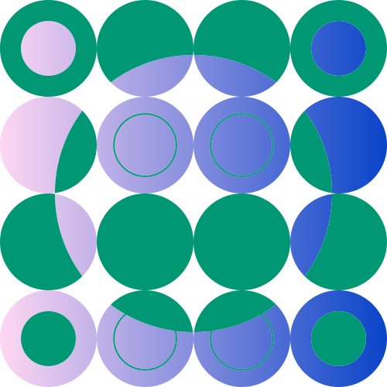
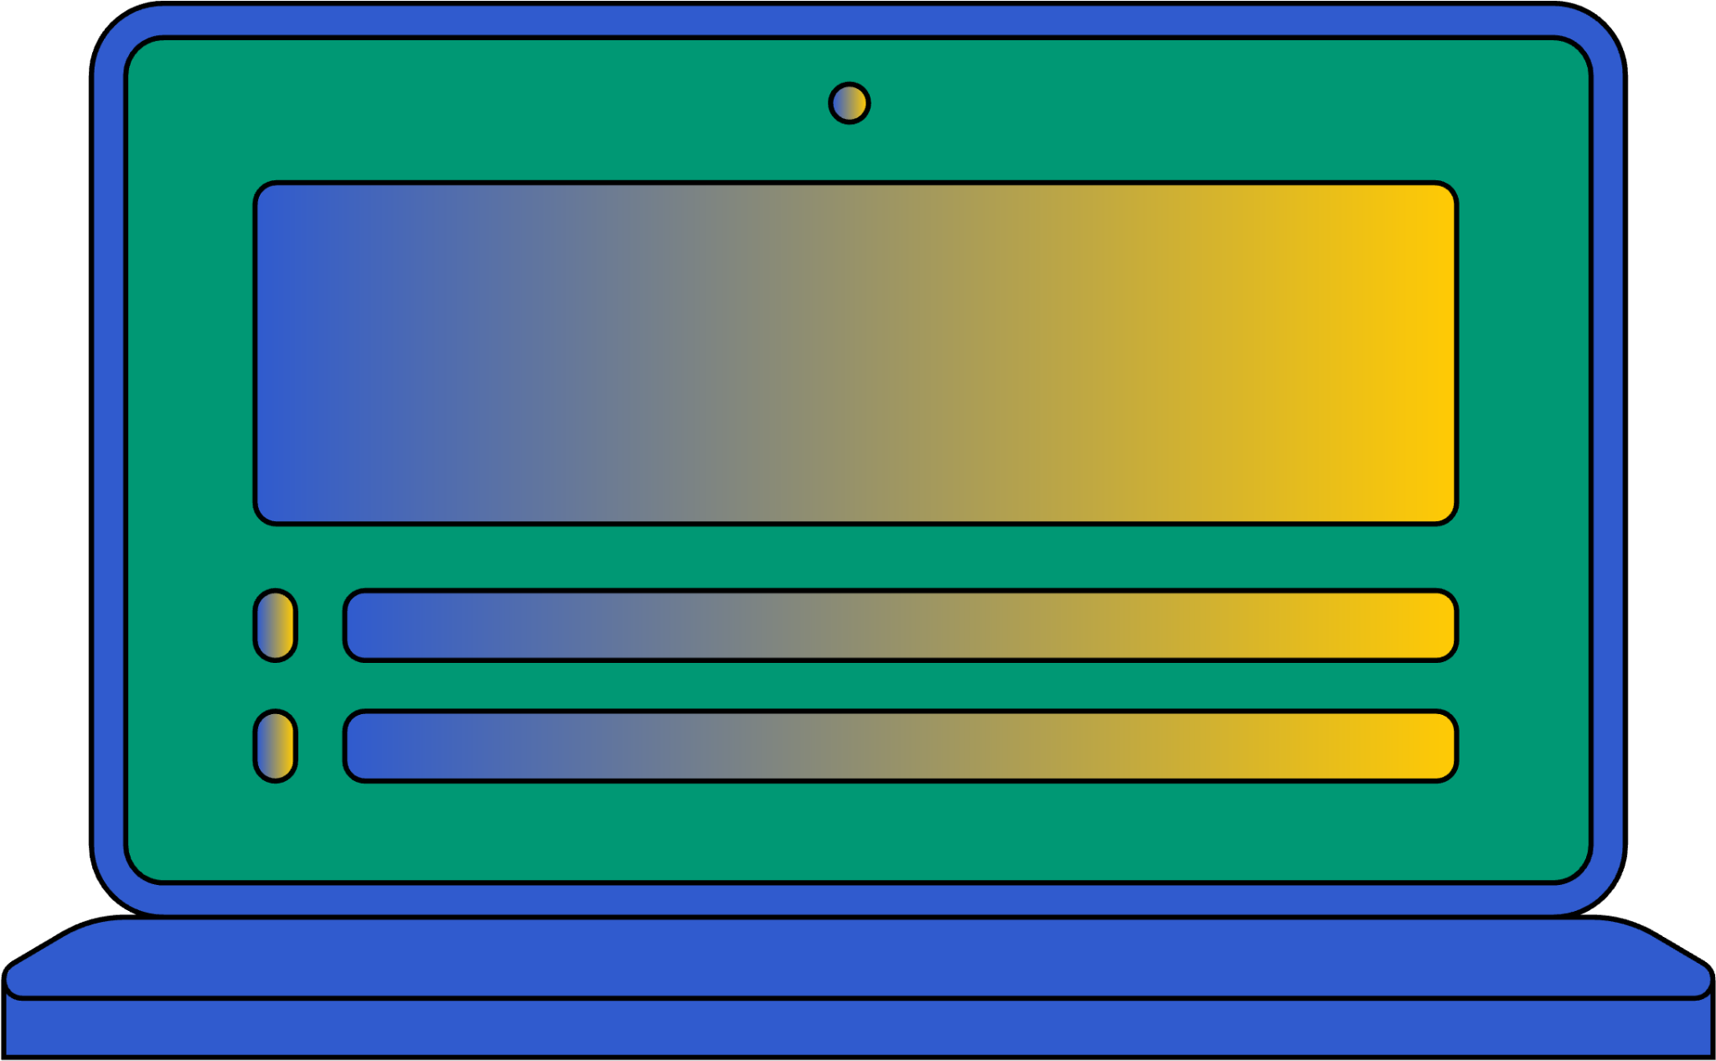
ANSWER SPHERE
INTRODUCTION TO HTML
PRESENTED BY PRATIK RAJ
DATE OF PRESENTATION :- 08/02/25
ANSWER SPHERE :- BUILT BY USING HTML

Slide 2
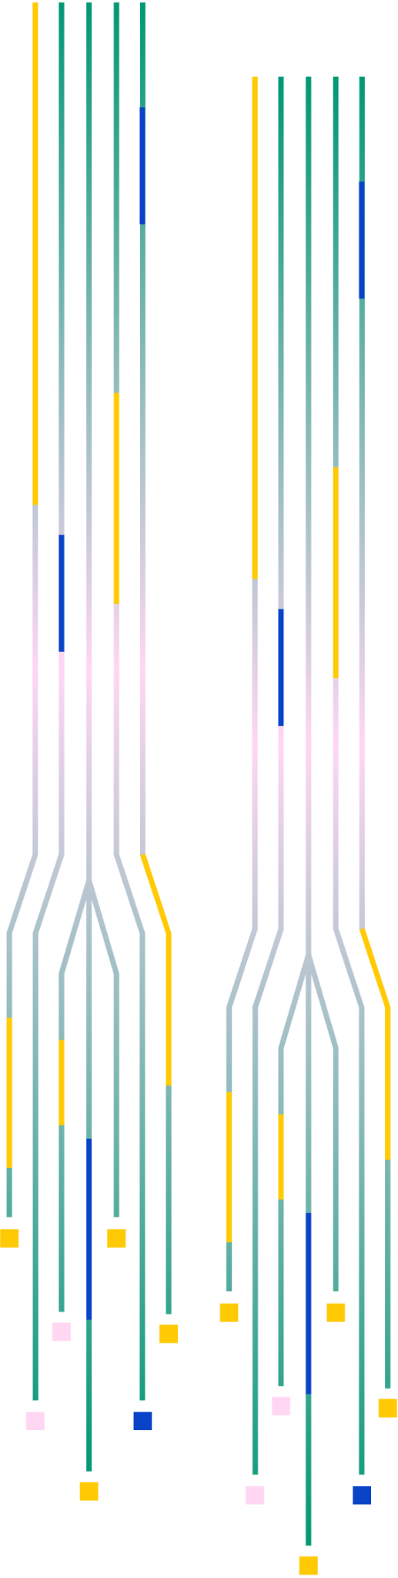
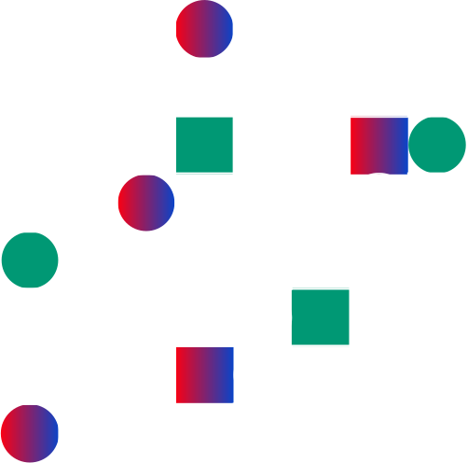

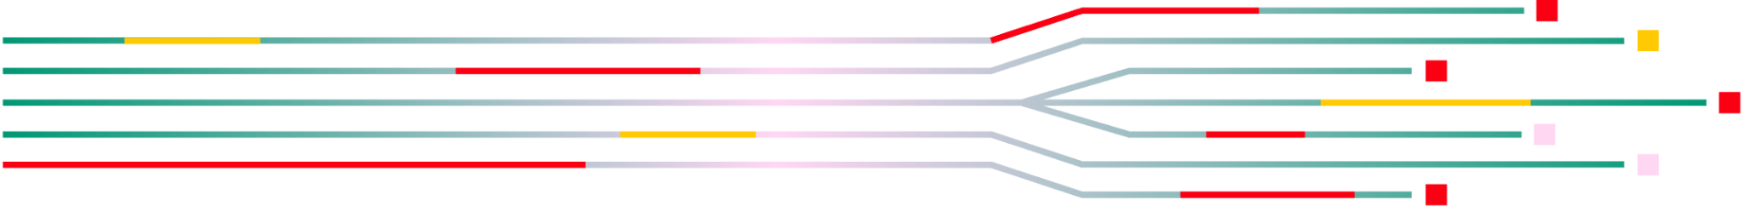
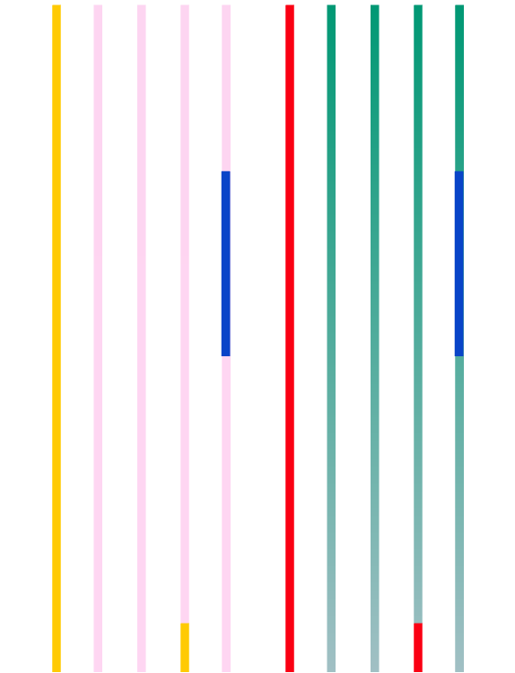
INTRODUCTION
TO HTML

Slide 3
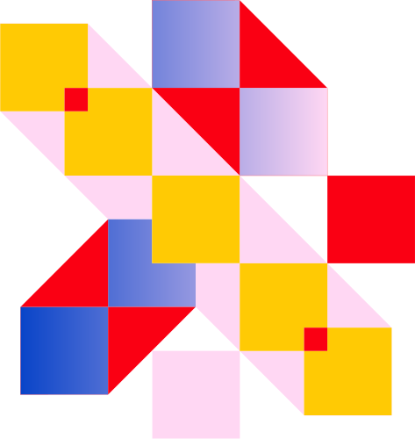

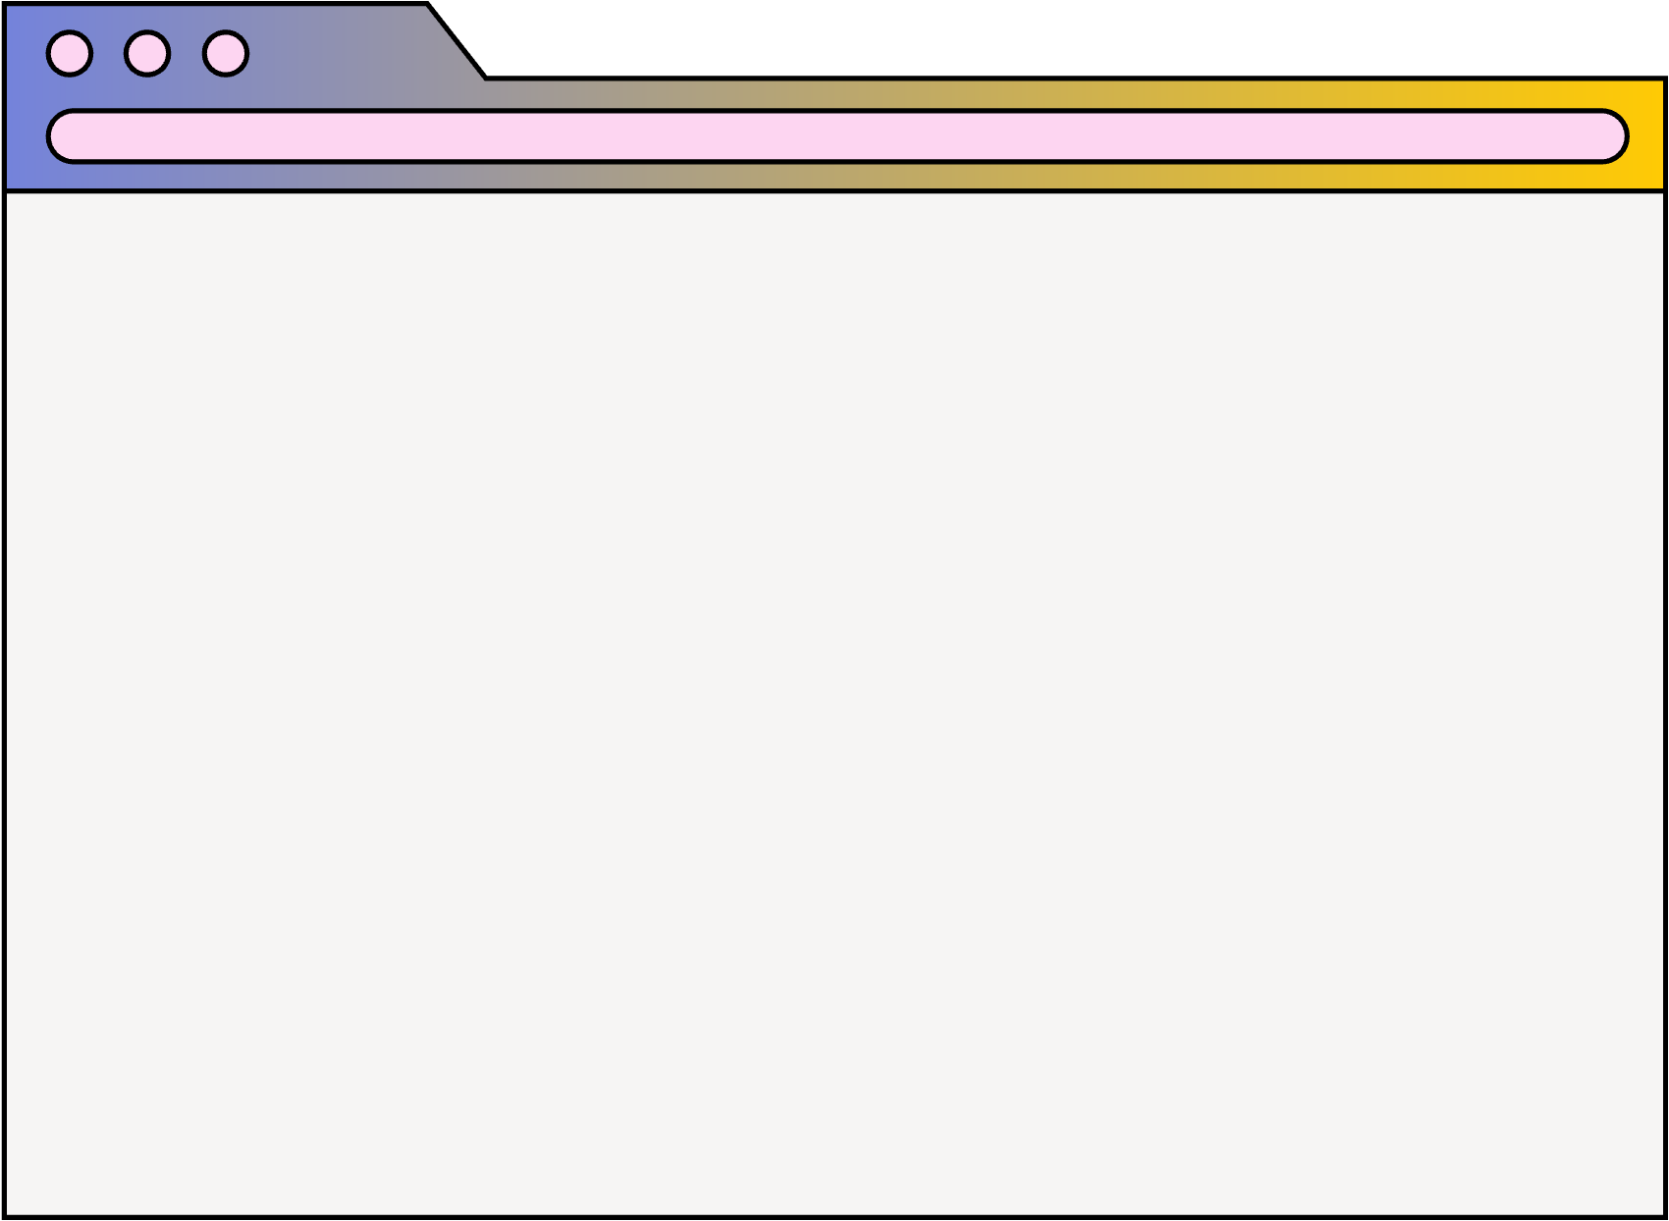


AGENDA
01
02
03
Overview of HTML
Basic Structure
HTML Tags & Element

Slide 4
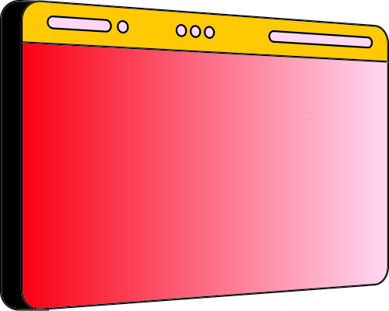
HTML (Hyper Text Markup Language) is the standard markup language used to create and structure content on web pages. It uses a system of tags and elements to organize text, images, links, and multimedia on the web. HTML provides the framework for web pages, allowing browsers to display content in a structured way. It forms the foundation of all web development, and every website is built using HTML, often alongside CSS for styling and JavaScript for interactivity. Whether it’s a simple static webpage or a complex dynamic site, HTML is essential for defining the structure and layout.

Slide 5
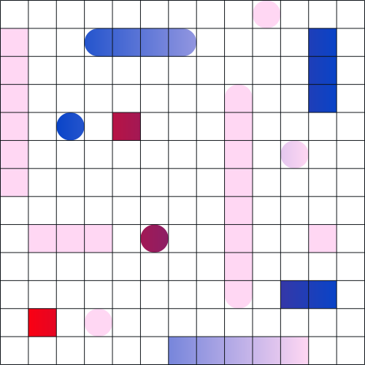


We are committed learners passionate about web development, focusing on mastering the foundations of HTML. Through certifications and practical projects, we have gained a solid understanding of how HTML structures the web. Our mission is to leverage this knowledge to create responsive, accessible, and visually appealing web pages while continuing to learn and grow in the ever-evolving world of web development.
ABOUT US

Slide 6



TUTORIAL OVERVIEW
1. BASIC STRUCTURES OF AN HTML DOCUMENT
2. KEY HTML ELEMENTS AND THEIR USAGE .
Understanding the core components of an html document , including tags like <head> , and , <body>, and how these elements work together to create a web pages
Exploring essential HTML tags like heading <h1> to <h6> ,paragraphs , images, and lists and how to implement them effectively.

Slide 7
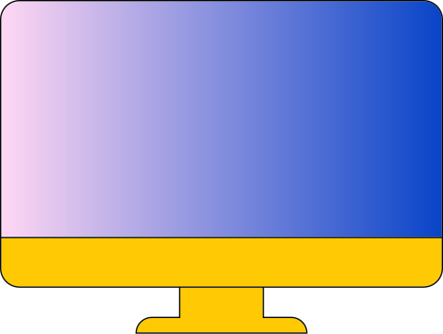
WHAT IS HTML?
EXAMPLE
DEFINITION
<!DOCTYPE html>
<html>
<head>
<title>My First Web Page</title>
</head>
<body>
<h1>Hello, World!</h1>
<p>This is a simple HTML document.</p>
</body>
</html>
HTML (Hyper Text Markup Language) is the standard language used to create and structure content on web pages. It uses a system of tags and elements to define the layout, text, images, and other multimedia on a webpage.
PURPOSE
Structuring Web Content: HTML provides the basic framework for web pages, defining headings, paragraphs, links, lists, images, and more. It allows developers to organize content in a meaningful and readable way.
Displaying Multimedia: HTML supports embedding multimedia elements like images, audio, video, and interactive forms, making web pages dynamic and interactive for users.

Slide 8
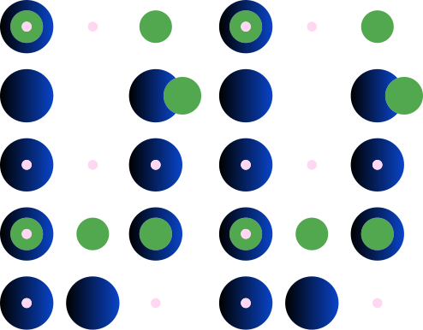



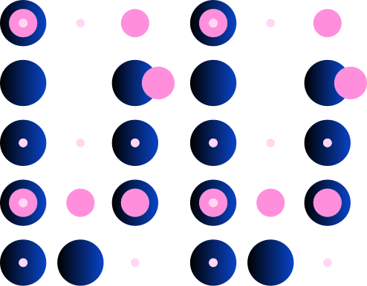
BASIC STRUCTURE
01
02
03
HTML DECLARATION AND ROOT ELEMENT
<!DOCTYPE html> : this tells the browser that the document follows HTML5 standards
2.. <html > : the root element that contains all other HTML content
HEAD SECTION
<head> : this section contains metadata about the document , such as title , character set , and links to stylesheet or scripts .
<title> : defines the title of the webpages , which appears on the browser tab .
BODY SECTION
<body> : this section contains all the visible content of the webpage , such as heading , paragraphs images and links.

Slide 9
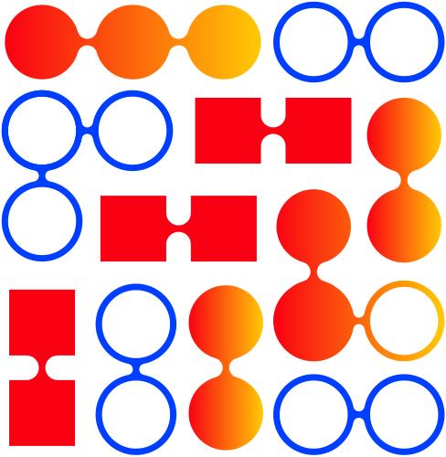
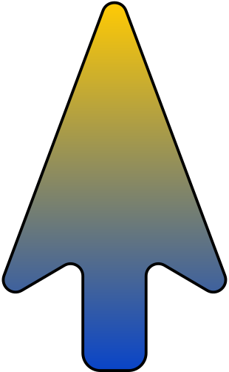
BRAINSTORM & IDEAS
Idea 1
Visual HTML Structure: Show a flowchart of HTML tags and their roles (head, body, etc.).
A
Idea 2
Real-World Examples: Show how websites like Wikipedia use basic HTML elements.
IDEA
Future Use: for learning CSS and JavaScript Explain how HTML is the foundation
Idea 1
B
Interactive Demos: Use live code examples to demonstrate tags affects web how changing pages.
Idea 2

Slide 10
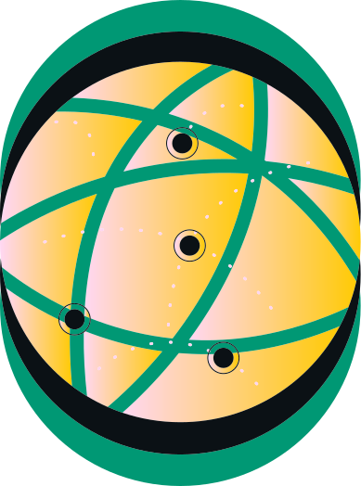
MAIN TOPICS & DETAILS
Topic 01
Topic 02
: What is HTML?
Definition: HTML (Hyper Text Markup Language) is the standard language used to create web pages.
Purpose: It structures content like text, images, and links on the web.
BASIC STRUCTURE OF HTML
Elements : includes <!DOCTYPE html> , <html> , < head> , and <body> .
Function : defines how content is organized and displayed on webpage .
Topic 03
Topic 04
Heading ( <h1> to <h6>) : used to create titles .
Paragraphs (<p>) : used for text blocks
Links (<a>): used to create clickable links .
What I learned : creating structured web pages using HTML tags .
Future applications : HTML is the foundation for learning CSS and Java script to crate dynamic interactive websites .

Slide 11

STEP-BY-STEP CODING
01
02
03
04
Topic 01
Topic 02
Topic 03
Topic 04
CREATE THE HTML DOCUMENT
<!DOCTYPE html>
<html>
<head>
<title>My First Webpage</title>
</head>
<body>
<!-- Page content goes here -->
</body>
</html>
ADD A HEADING AND PARAGRAPH
<h1>Welcome to My Website</h1>
<p>This is my first webpage using HTML.</p>
ADD ALINK
<a href="https://example.com">Visit Example Website</a>
.
ADD A IMAGE
< img src = "image.jpg" alt="A description of the image">

Slide 12

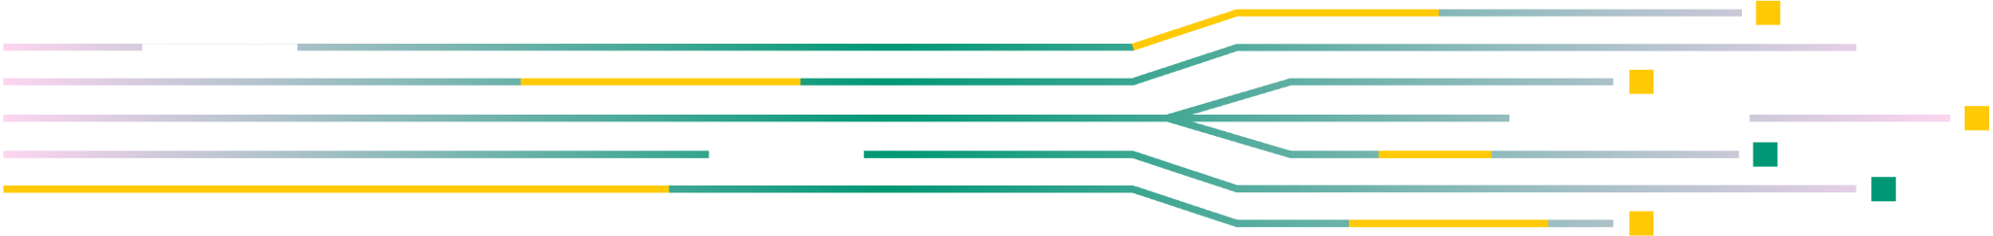
"LEARNING HTML IS LIKE LEARNING THE ALPHABET BEFORE YOU WRITE YOUR FIRST NOVEL."

Slide 13
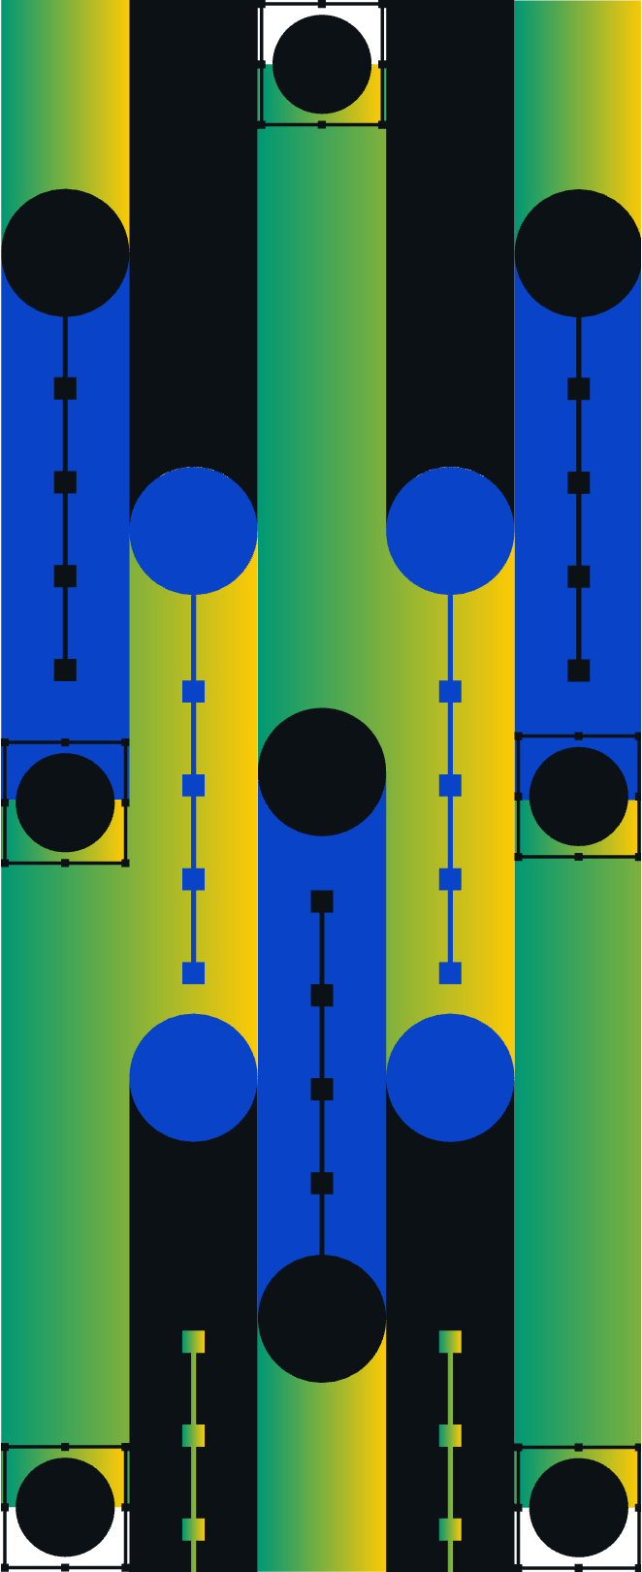

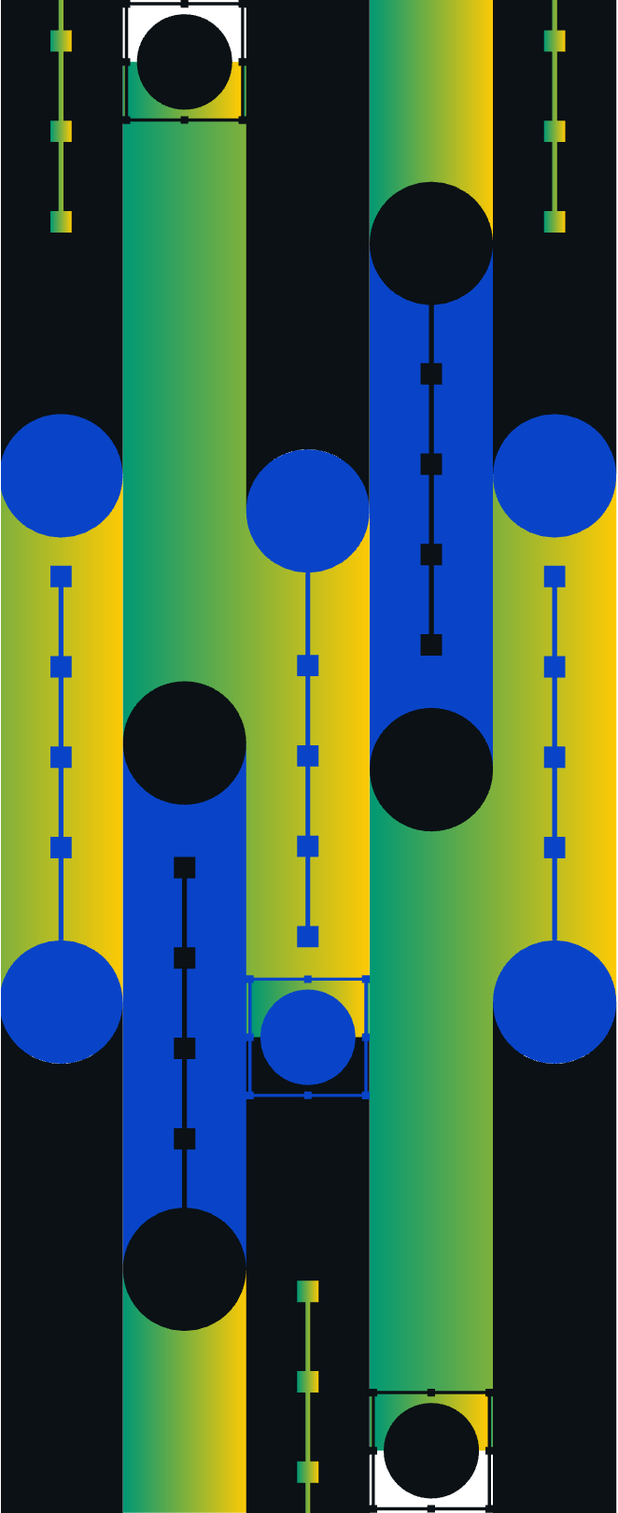
THANK YOU
HTML (Hyper Text Markup Language) is the standard language used to create and structure web pages. It uses tags and elements to define the content and layout of a webpage, such as headings, paragraphs, images, and links. HTML provides the foundation for websites, allowing browsers to interpret and display content for users. Every webpage starts with HTML, and it can be enhanced with CSS for styling and JavaScript for interactive functionality. Learning HTML is the first step in web development, enabling developers to create structured and accessible web pages.

Slide 14
ANSWER SPHERE

Slide 15

PROJECT OVERVIEW
01
”ANSWER SPHERE" is a chatbot platform that allows users to interact with an AI simulation.
Topic 01
02
Topic 02
Built. using HTML for structure, CSS for styling, and JavaScript for interaction
03
Topic 03
Users can send text-based commands to the chatbot, which responds accordingly and can even open specific websites

Slide 16
CSS: Provides styling for the chatbot, making it visually appealing and responsive. For example, the gradient text for the chatbot title and the responsive chat message boxes.
PURPOSE OF THE PROJECT
01
Topic 01
The primary goal is to create a user-friendly chatbot that simulates conversation, similar to ChatGPT..
02
This project demonstrates the use of front-end technologies to build interactive web applications.
Topic 02
03
Topic 03
helps users understand how basic web technologies can create a dynamic chatbot experience..

Slide 17
CSS: Provides styling for the chatbot, making it visually appealing and responsive. For example, the gradient text for the chatbot title and the responsive chat message boxes.
KEY FEATURES
01
Topic 01
. User Interaction: Users can type commands like "hello," "who are you," or "how are you," and the chatbot will respond with pre-defined messages.
02
Dynamic Web Links: The chatbot can open websites like YouTube, Instagram, and Google directly from the chat.
Topic 02
03
Topic 03
Chat Simulation: The bot can respond to common queries, offer jokes, quotes, and even guide users to check the weather or news through external links..

Slide 18
CSS: Provides styling for the chatbot, making it visually appealing and responsive. For example, the gradient text for the chatbot title and the responsive chat message boxes.
TECHNOLOGY USED
01
Topic 01
. HTML : Structures the chatbot interface with headers, input fields, and the chat message container.
02
CSS : Provides styling for the chatbot, making it visually appealing and responsive. For example, the gradient text for the chatbot title and the responsive chat message boxes.
Topic 02
03
Topic 03
JavaScript : Handles the chatbot's functionality, including : Sending and receiving messages.
Simulating AI responses to user input.
Opening external links like YouTube, Google, and more.

Slide 19
COMMANDS SUPPORTED
Website Commands: "open YouTube", "open Facebook", "open Google", "open WhatsApp", etc.
General Queries: "hello", "how are you", "who are you", "news", "weather", "quote"

Slide 20
Fast Link Handling: Opening websites through commands happens quickly, with minimal delay in navigation.
PERFORMANCE
01
"Quick Response Time: The chatbot processes user inputs and displays responses almost instantly, providing a smooth experience.
Topic 01
02
Topic 02
Fast Link Handling: Opening websites through commands happens quickly, with minimal delay in navigation.
03
Responsive Design: The interface adapts seamlessly to different screen sizes, ensuring consistent performance across desktops, tablets, and mobile device
Topic 03

Slide 21
FUTURE ENHANCEMENTS
01
02
03
AI Integration: Plan to integrate real AI capabilities for more intelligent responses.
. Backend Development: Adding a server-side component to handle more complex operations and store conversations.
Design Improvements: Enhancing the UI with better animations, themes, and a more professional look..

Slide 22
CODE USED

Slide 23


HTML CODE
<!DOCTYPE html>
<html lang="en">
<head>
<meta charset="UTF-8">
<meta name="viewport" content="width=device-width, initial-scale=1.0">
<title>ChatGPT Clone</title>
<link rel="stylesheet" href="style.css">
</head>
<body>
<div class="container">
<h1>ANSWER SPHERE !</h1>
<h2>Chat with AI</h2>
<div class="chat-container" id="chatContainer">
<!-- Chat messages will appear here -->
</div>
<div class="prompt-area">
<input type="text" id="userInput" placeholder="Type your message..." />
<button class="btn" onclick="sendMessage()">Send</button>
</div>
<!-- Pratik's Name in Top-Right Corner -->
<div class="name-container">
<p>Pʀᴀᴛɪᴋ ꜱᴘʜᴇʀᴇ𝗫 </>
</div>
</div>
<script src="app.js"></script>
</body>
</html>

Slide 24
CSS CODE
* {
margin: 0;
padding: 0;
box-sizing: border-box;
font-family: 'Gill Sans', 'Gill Sans MT', Calibri, 'Trebuchet MS', sans-serif;
}
body {
width: 100%;
height: 100%;
background-color: rgb(27, 33, 41);
}
.container {
width: 100%;
height: 100vh;
display: flex;
align-items: center;
justify-content: center;
flex-direction: column;
gap: 20px;
padding-top: 100px;
}
.container h1 {
display: inline-block;
font-size: 7vw;
background: linear-gradient(to right, white, rgb(45, 183, 225), rgb(196, 14, 93));
background-clip: text;
-webkit-text-fill-color: transparent;
}
.container h2 {
font-size: 3vw;
color: rgb(241, 241, 241);
}
.chat-container {
width: 100%;
max-height: none; /* Allow the chat container to grow infinitely */
overflow-y: auto;
padding: 20px;
display: flex;
flex-direction: column;
gap: 20px;
margin-bottom: 80px; /* Add some space for input */
}
.chat-message {
padding: 15px;
border-radius: 15px;
font-size: 16px;
max-width: 80%;
word-wrap: break-word;
}
.user-message {
background-color: rgb(96, 136, 173);
align-self: flex-end;
color: white;
}
ai-message {
background-color: rgba(120, 169, 215, 0.7);
align-self: flex-start;
color: white;
}
.prompt-area {
width: 100%;
background-color: rgb(27, 33, 41);
padding: 10px;
position: fixed;
bottom: 0;
display: flex;
justify-content: center;
}
#userInput {
width: 70%;
padding: 10px;
border-radius: 20px;
border: 2px solid #ccc;
font-size: 16px;
margin-right: 10px;
color: white;
background-color: rgb(27, 33, 41);
}
.btn {
width: 15%;
padding: 10px;
background-color: rgb(10, 183, 235);
color: white;
border-radius: 20px;
border: none;
cursor: pointer;
}
.btn:hover {
background-color: rgba(14, 122, 155, 0.7);
}
/* Added Styles to Position Name in Right-Top Corner */
.name-container {
position: absolute;
top: 30px; /* Positioned at the top */
right: 30px; /* Positioned to the right */
font-size: 2vw;
font-weight: bold;
color: #f1f1f1;
text-shadow: 0 0 10px rgba(255, 255, 255, 0.8), 0 0 20px rgba(45, 183, 225, 0.8);
}
#name {
animation: glow 1.5s ease-in-out infinite alternate;
}
@keyframes glow {
0% { text-shadow: 0 0 5px rgba(255, 255, 255, 0.8); }
100% { text-shadow: 0 0 20px rgba(255, 165, 0, 0.9), 0 0 30px rgba(30, 144, 255, 0.9); }
}

Slide 25
JAVASCRIPT
} else if (lowerMessage.includes("twitter")) {
window.open("https://www.twitter.com", "_blank");
return "Opening Twitter for you!";
} else if (lowerMessage.includes("instagram")) {
window.open("https://www.instagram.com", "_blank");
return "Opening Instagram for you!";
} else if (lowerMessage.includes("google")) {
window.open("https://www.google.com", "_blank");
return "Opening Google for you!";
} else if (lowerMessage.includes("spotify")) {
window.open("https://www.spotify.com", "_blank");
return "Opening Spotify for you!";
} else if (lowerMessage.includes("whatsapp")) {
window.open("https://www.whatsapp.com", "_blank");
return "Opening WhatsApp for you!";
} else if (lowerMessage.includes("weather")) {
return "I can't provide websites like Weather.com!";
} else if (lowerMessage.includes("news")) {
return "For the latest news, you can visit websites like BBC News or CNN.";
} else if (lowerMessage.includes("joke")) {
return "Why don't skeletons fight each other? They don't have the guts!";
} else if (lowerMessage.includes("quote")) {
return "'The only way to do great work is to love what you do.' - Steve Jobs";
} else if (lowerMessage.includes("vs code") || lowerMessage.includes("vscode")) {
window.open("https://code.visualstudio.com", "_blank");
return "Opening Visual Studio Code for you!";
} else {
return "Sorry, I didn't quite get that. Can you ask something else?";
}
}
// Get elements
const chatContainer = document.getElementById("chatContainer");
const userInput = document.getElementById("userInput");
// Function to send a message
function sendMessage() {
const message = userInput.value.trim();
if (message === "") return; // Ignore if the message is empty
// Append the user message to the chat container
const userMessageDiv = document.createElement("div");
userMessageDiv.classList.add("chat-message", "user-message");
userMessageDiv.textContent = message;
chatContainer.appendChild(userMessageDiv);
// Clear the input field
userInput.value = "";
chatContainer.scrollTop = chatContainer.scrollHeight; // Scroll to the bottom
// Simulate AI response
setTimeout(() => {
const aiMessageDiv = document.createElement("div");
aiMessageDiv.classList.add("chat-message", "ai-message");
aiMessageDiv.textContent = getAIResponse(message);
chatContainer.appendChild(aiMessageDiv);
chatContainer.scrollTop = chatContainer.scrollHeight; // Scroll to the bottom
}, 1000); // Simulate a 1-second delay for the AI response
}
// Simulated AI response and opening links
function getAIResponse(message) {
const lowerMessage = message.toLowerCase();
if (lowerMessage.includes("hello")) {
return "Hello user ! How can I assist you today?";
} else if (lowerMessage.includes("how are you")) {
return "I'm just a AI assistant, but I'm doing well, thanks for asking!";
} else if (lowerMessage.includes("who are you")) {
return "I am an AI assistant created by Pʀᴀᴛɪᴋ ꜱᴘʜᴇʀᴇ𝗫 to assist you with tasks and answer.";
} else if (lowerMessage.includes("help")) {
return "I can help you with opening websites, answering questions, and providing information!";
} else if (lowerMessage.includes("your name")) {
return "I don't have a specific name, but you can call me Pʀᴀᴛɪᴋ ꜱᴘʜᴇʀᴇ𝗫 ";
} else if (lowerMessage.includes("thank you")) {
return "You're welcome! Feel free to ask if you need anything else.";
} else if (lowerMessage.includes("bye")) {
return "Goodbye! Have a great day!";
} else if (lowerMessage.includes("youtube")) {
window.open("https://www.youtube.com", "_blank");
return "Opening YouTube for you!";
} else if (lowerMessage.includes("chrome")) {
window.open("https://www.google.com/chrome/", "_blank");
return "Opening Chrome download page!";
} else if (lowerMessage.includes("chatgpt")) {
window.open("https://chat.openai.com", "_blank");
return "Opening ChatGPT for you!";
} else if (lowerMessage.includes("facebook")) {
window.open("https://www.facebook.com", "_blank");
return "Opening Facebook for you!";

Slide 26
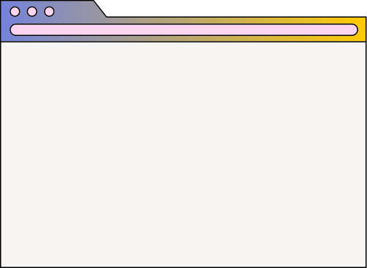
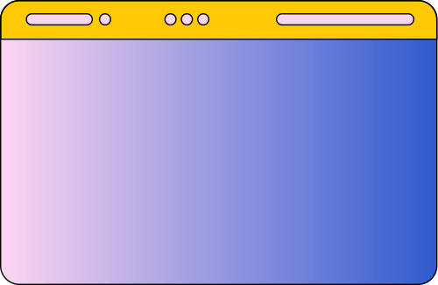
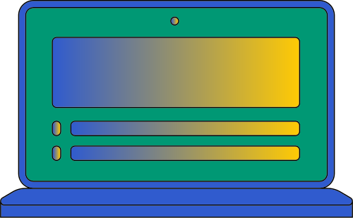





RESOURCE
PAGE
Use these design resources
in your Canva Presentation.
This presentation template
uses the following free fonts:
Titles: Paytone One
Headers: Lato
Body Copy: Lato
You can find these fonts
online too. Happy designing!
Don't forget to delete this
page before presenting.

Slide 27
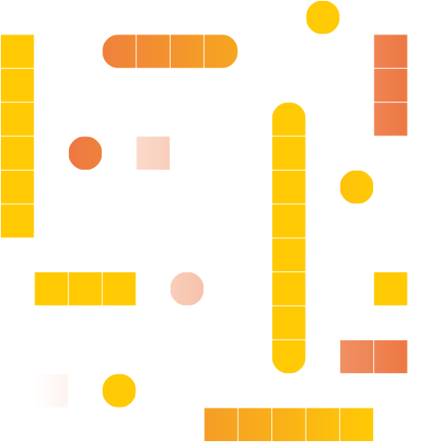
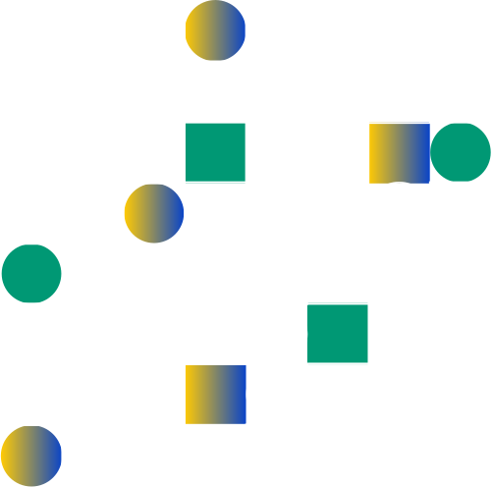
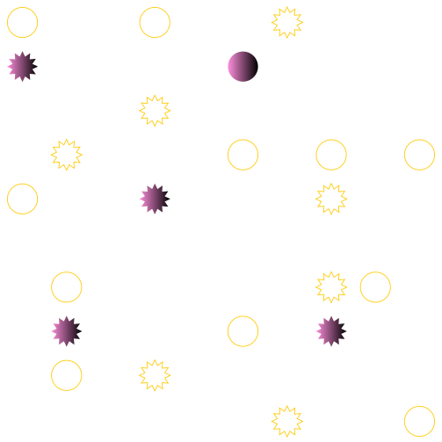
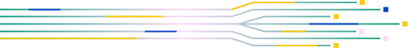
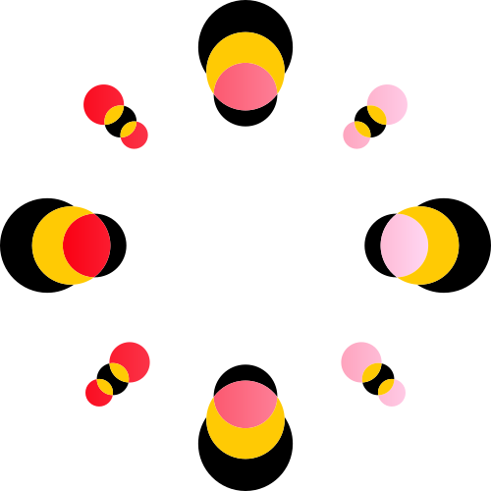
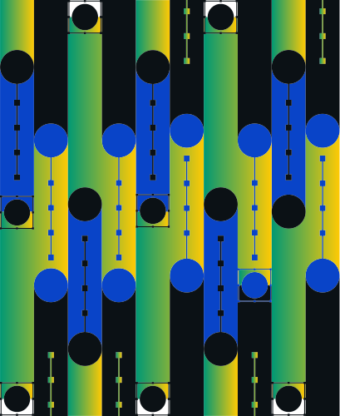


Slide 28
THANK YOU !

